Slide 1
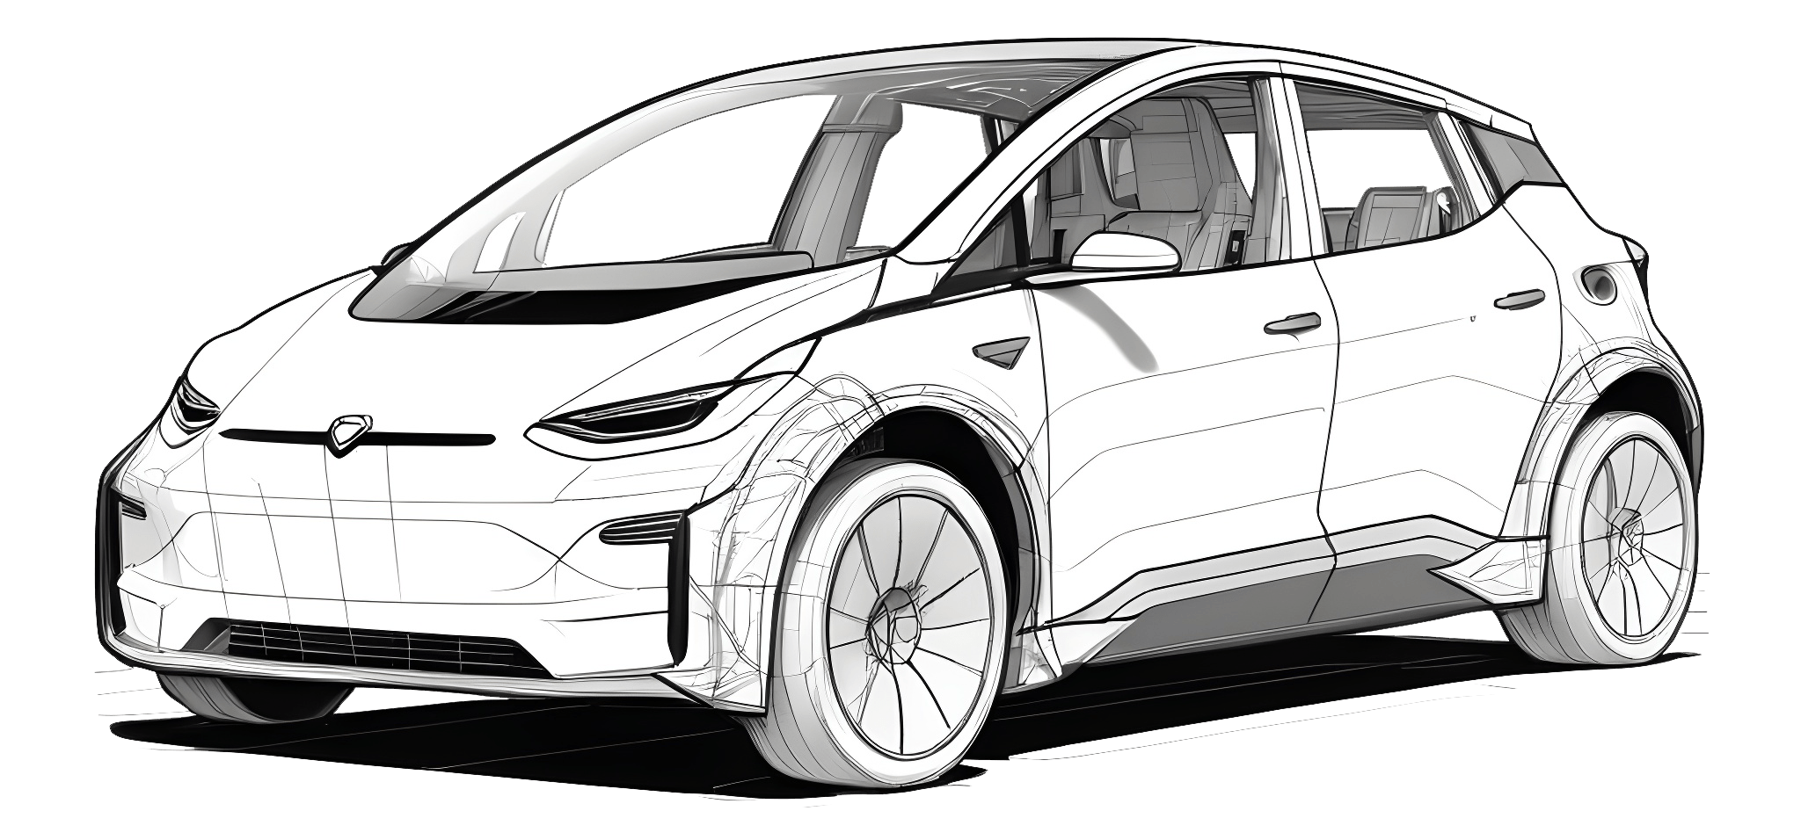
Title: DriftAI – Predicting Drifting Angle with AI
Jagadeeswari J M
22dsc216
Guide: Dr.D. Gandhimadhi
Department of Data science

Slide 2
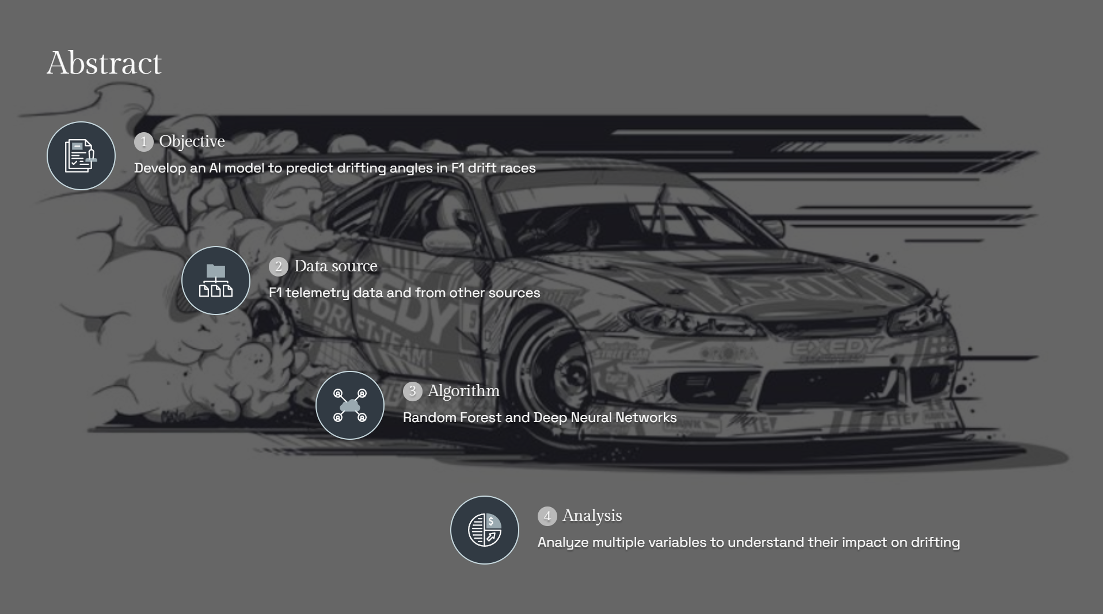

Slide 3
Data Set Details
Key Attributes:
Time-based: event_date, run_number
Driver/Car: driver_name, car_name
Track: track_name, track_temperature_c
Performance: speed_km_h, steering_angle_deg, throttle_position_percent
Mechanical: brake_pressure_bar, gear, engine_rpm

Slide 4
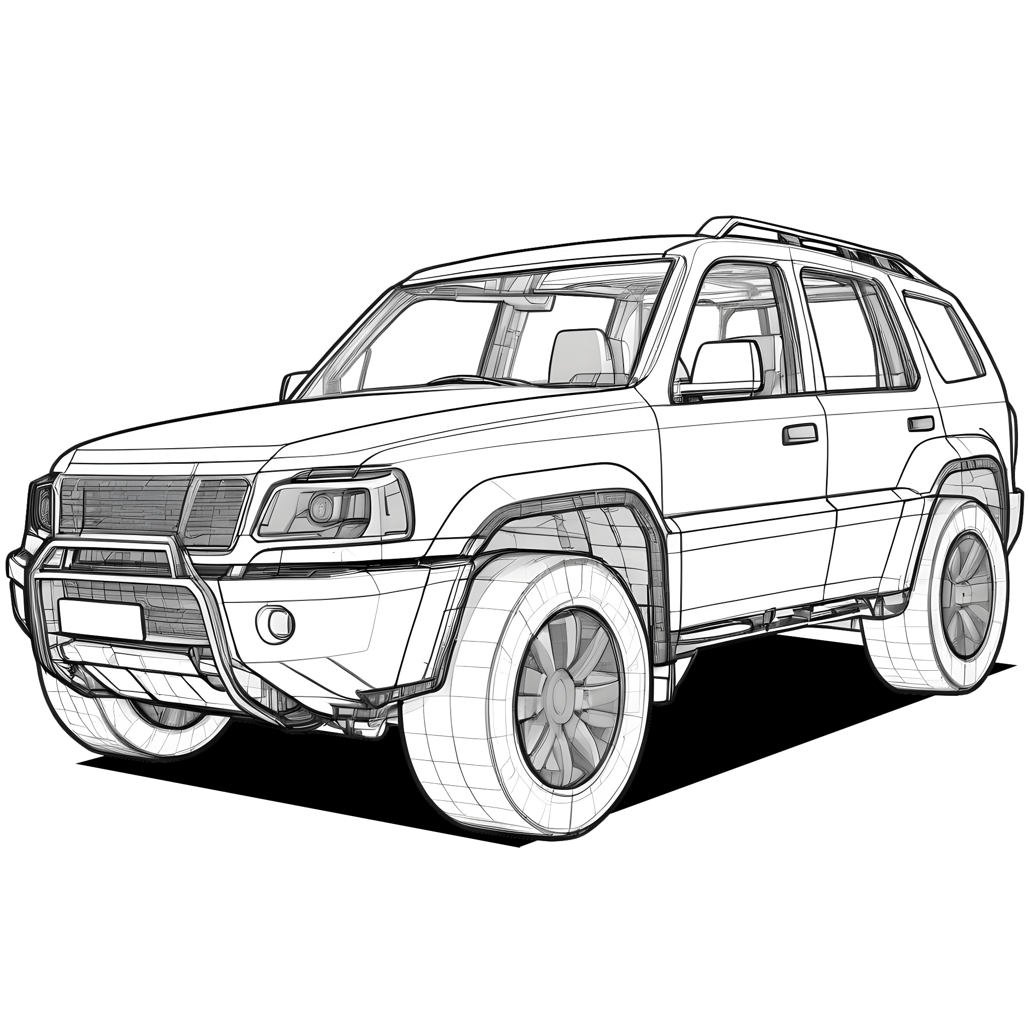
Module Description
Data Preprocessing
Model development
Loading data from Excel file. Feature selection and target variable identification and split data.
Using the algorithm which is Random Forest Regressor and DNN.
Training process for both models. Continuous evaluation of model accuracy.
Refinement based on new data and race outcomes
Performance Analysis
Model Training and Evaluation

Slide 5
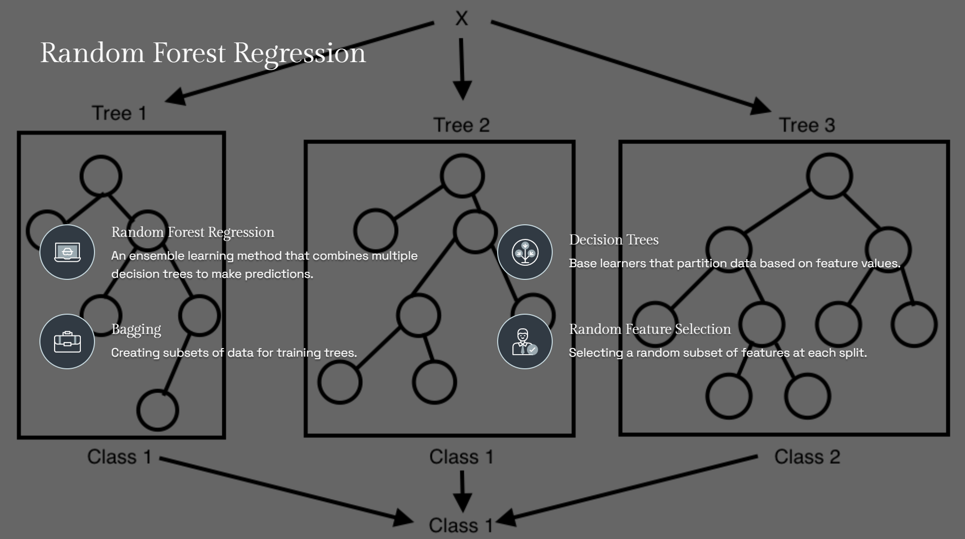

Slide 6
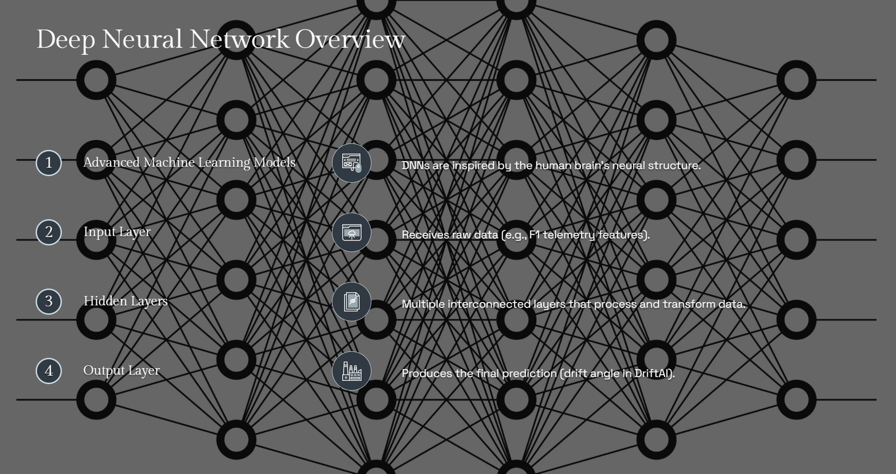

Slide 7
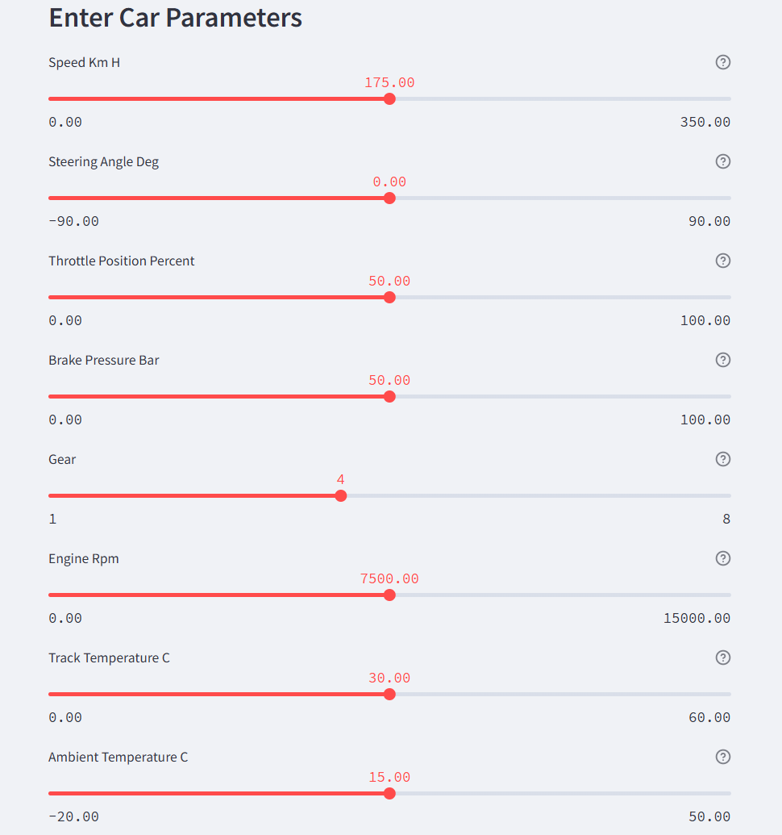
Project Implementation
Streamlit: For building an interactive dashboard to predict and visualize drift angles in real time.
TensorFlow: Used to build and train the DNN model for drift angle prediction.
Scikit-learn: Applied for training the Random Forest model.
Plotly: For creating interactive visualizations, including drift angle predictions and feature importance.
Pandas & NumPy: For efficient data manipulation and handling large datasets.

Slide 8
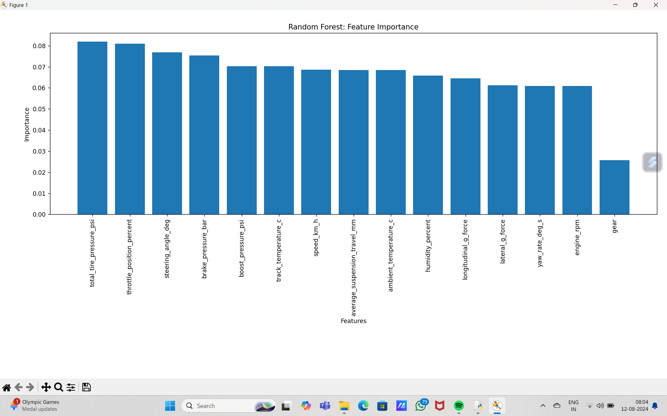
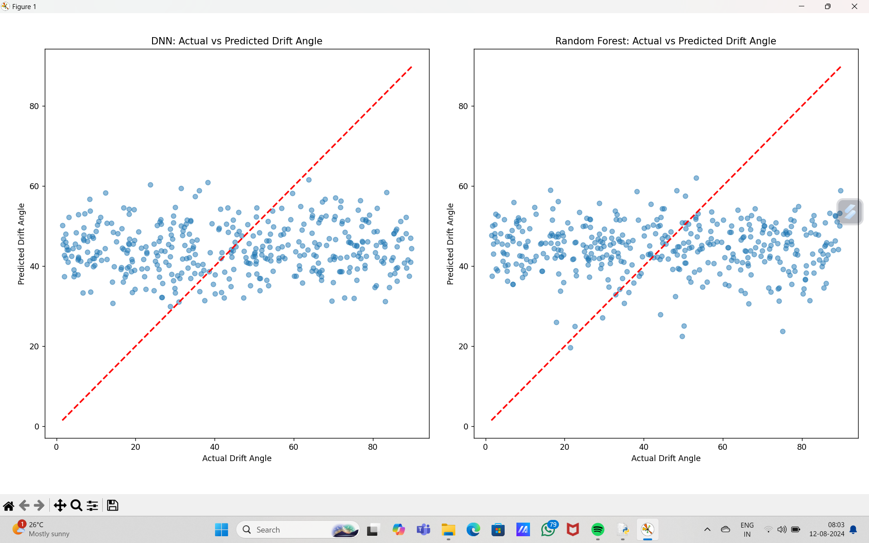
Result

Slide 9
Future Enhancements:
Expanded Dataset: Add variables like tire pressure, road conditions, and weather for better accuracy.
Real-Time Integration: Focus on real-time deployment in vehicles for instant feedback.
Autonomous Vehicles: Extend DriftAI for improved control in autonomous driving.
Model Improvements: Optimize the DNN architecture with different activation functions and optimizers for better performance.
Conclusion:
Developed ML models for accurate drift angle prediction.
DNN model excelled in generalizing across various driving scenarios.
Potential application in ADAS and autonomous vehicles for real-time drift warnings, improving driving safety.

Slide 10
References
Book References:
Deep Learning – Goodfellow, Bengio & Courville
Machine Learning: A Probabilistic Perspective – Murphy
Python Machine Learning –Raschka & Mirjalili
Web References:
Scikit-learn Documentation: scikit-learn.org
TensorFlow Documentation: tensorflow.org
Keras Documentation: keras.io Random Forest - Leo Breiman (2001):stat.berkeley.edu
Adam Optimizer - Kingma & Ba (2014arxiv.org

Slide 11
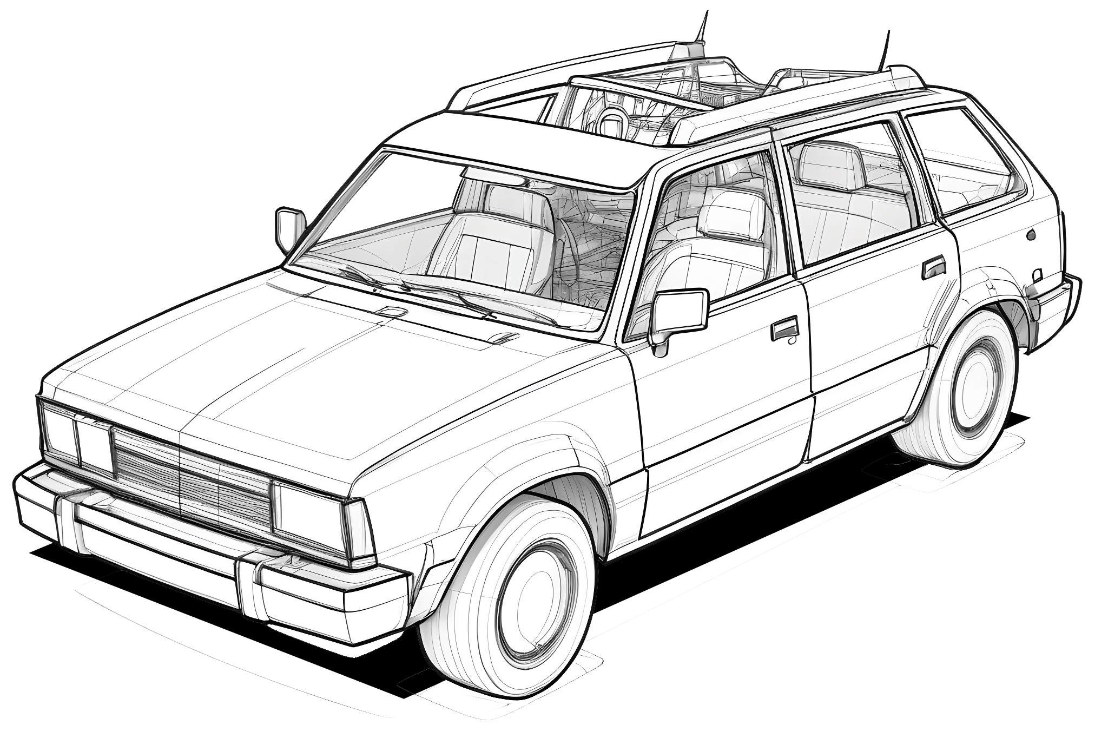

Thank you

